Slide 1
Imagery

Slide 2
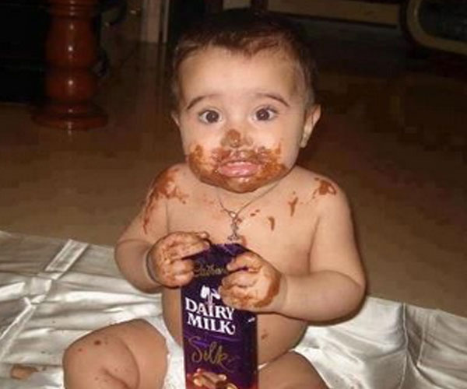
Imagery - representation through language of a sensory experience

Slide 3
Visual imagery
something described through sight

Slide 4
Visual imagery
something described through sight

Slide 5
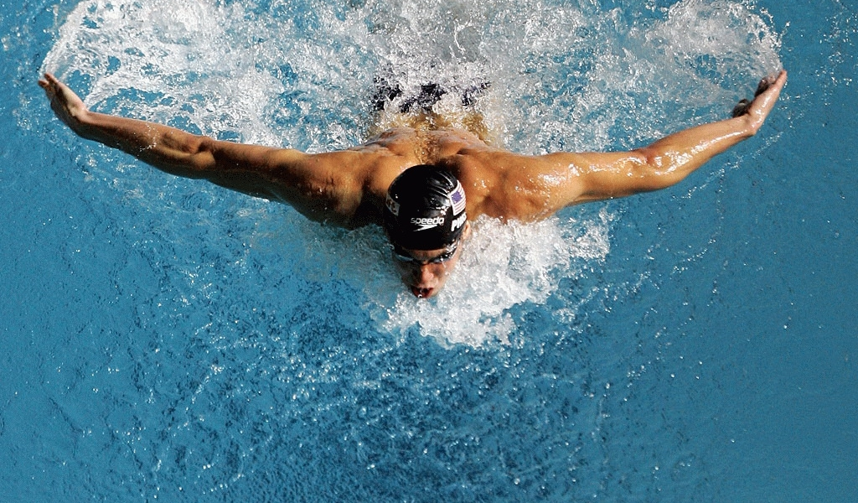
Auditory imagery
representation of a sound

Slide 6
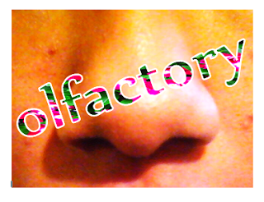
Olfactory imagery
representation of a smell

Slide 7
Gustatory imagery
representation of a taste

Slide 8
Tactile imagery
touch: hardness, softness, wetness, heat, cold

Slide 9
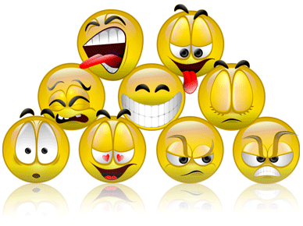
Organic imagery
internal sensation, hunger, thirst, fatigue, nausea…
And emotions

